Slide 1
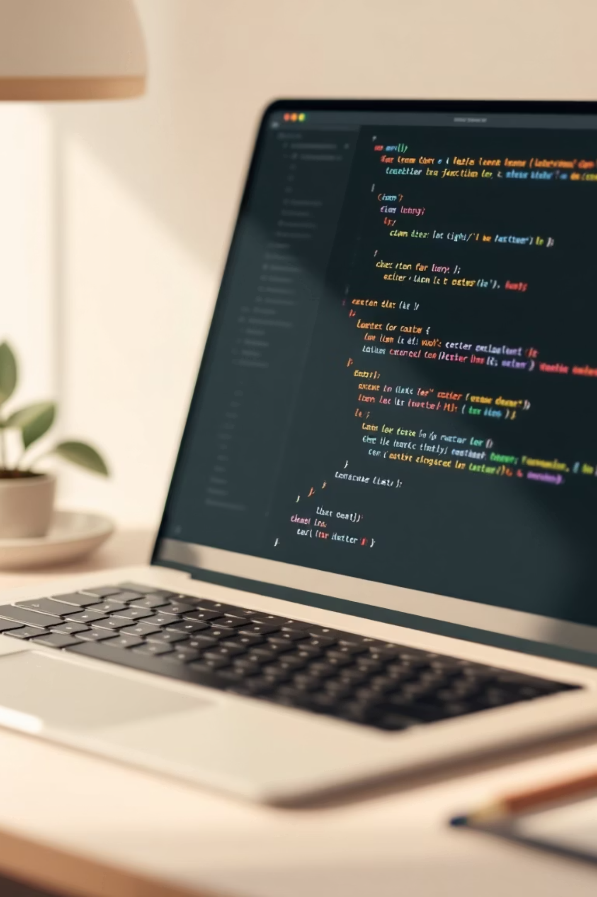
Getting Started with Python: Pre-requisites, Setup, and Basics
Your comprehensive guide to launching your Python programming journey with confidence and clarity.

Slide 2
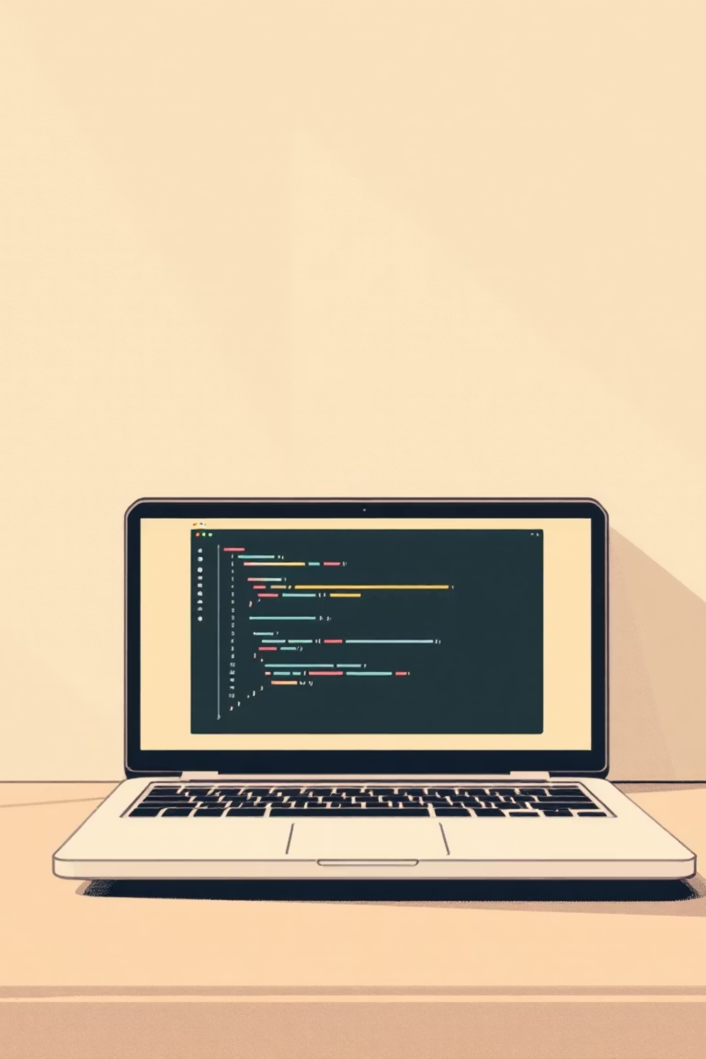

Hardware & Software Pre-requisites
Hardware Requirements
Operating Systems
Minimum 4GB RAM and 5GB free disk space. Desktop or laptop with a modern processor ensures smooth development experience.
macOS, Linux, or Windows supported. Linux and macOS offer native UNIX compatibility for seamless development workflows.
Why UNIX Matters
Most production servers run Linux. Learning UNIX-based systems early helps you build skills that align with real-world deployment environments.

Slide 3
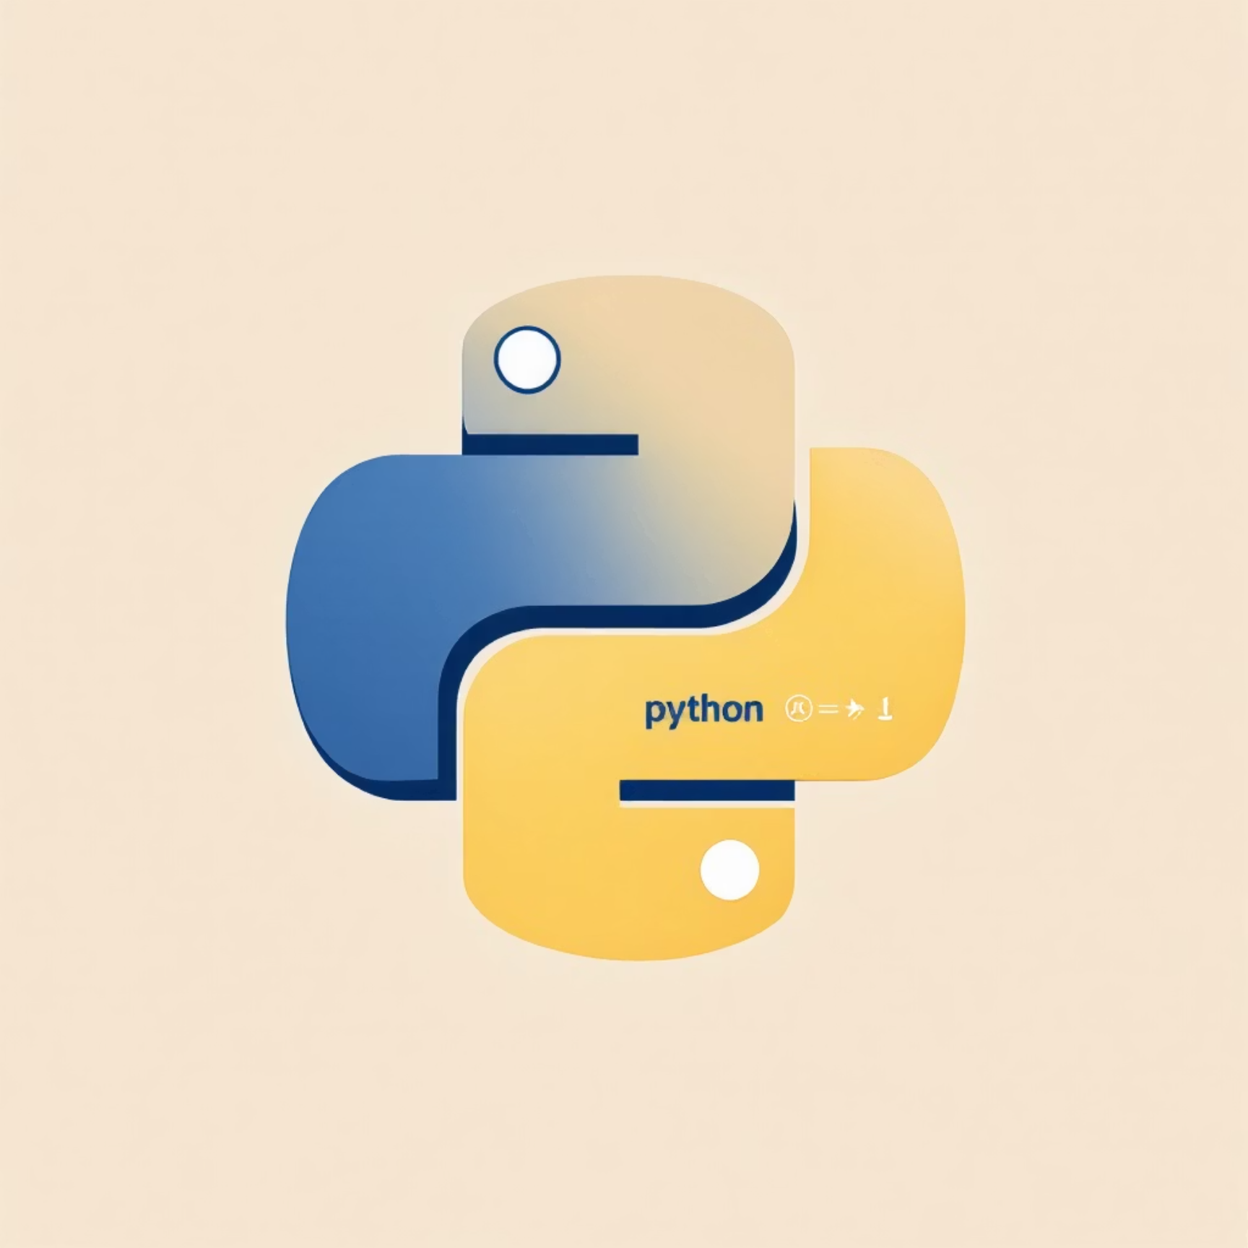

Installing Python: Your Options
Easy Installation Routes
01
Microsoft Store (Windows)
Quick install with automatic updates for latest Python 3 version.
02
Official Installer
Download from python.org for precise version control across macOS, Linux, and Windows.
03
Specialized Distributions
Anaconda for data science, WinPython for portable environments, MicroPython for embedded systems.
Pro Tip: Beginners should start with the official installer or Microsoft Store for a straightforward setup experience.

Slide 4
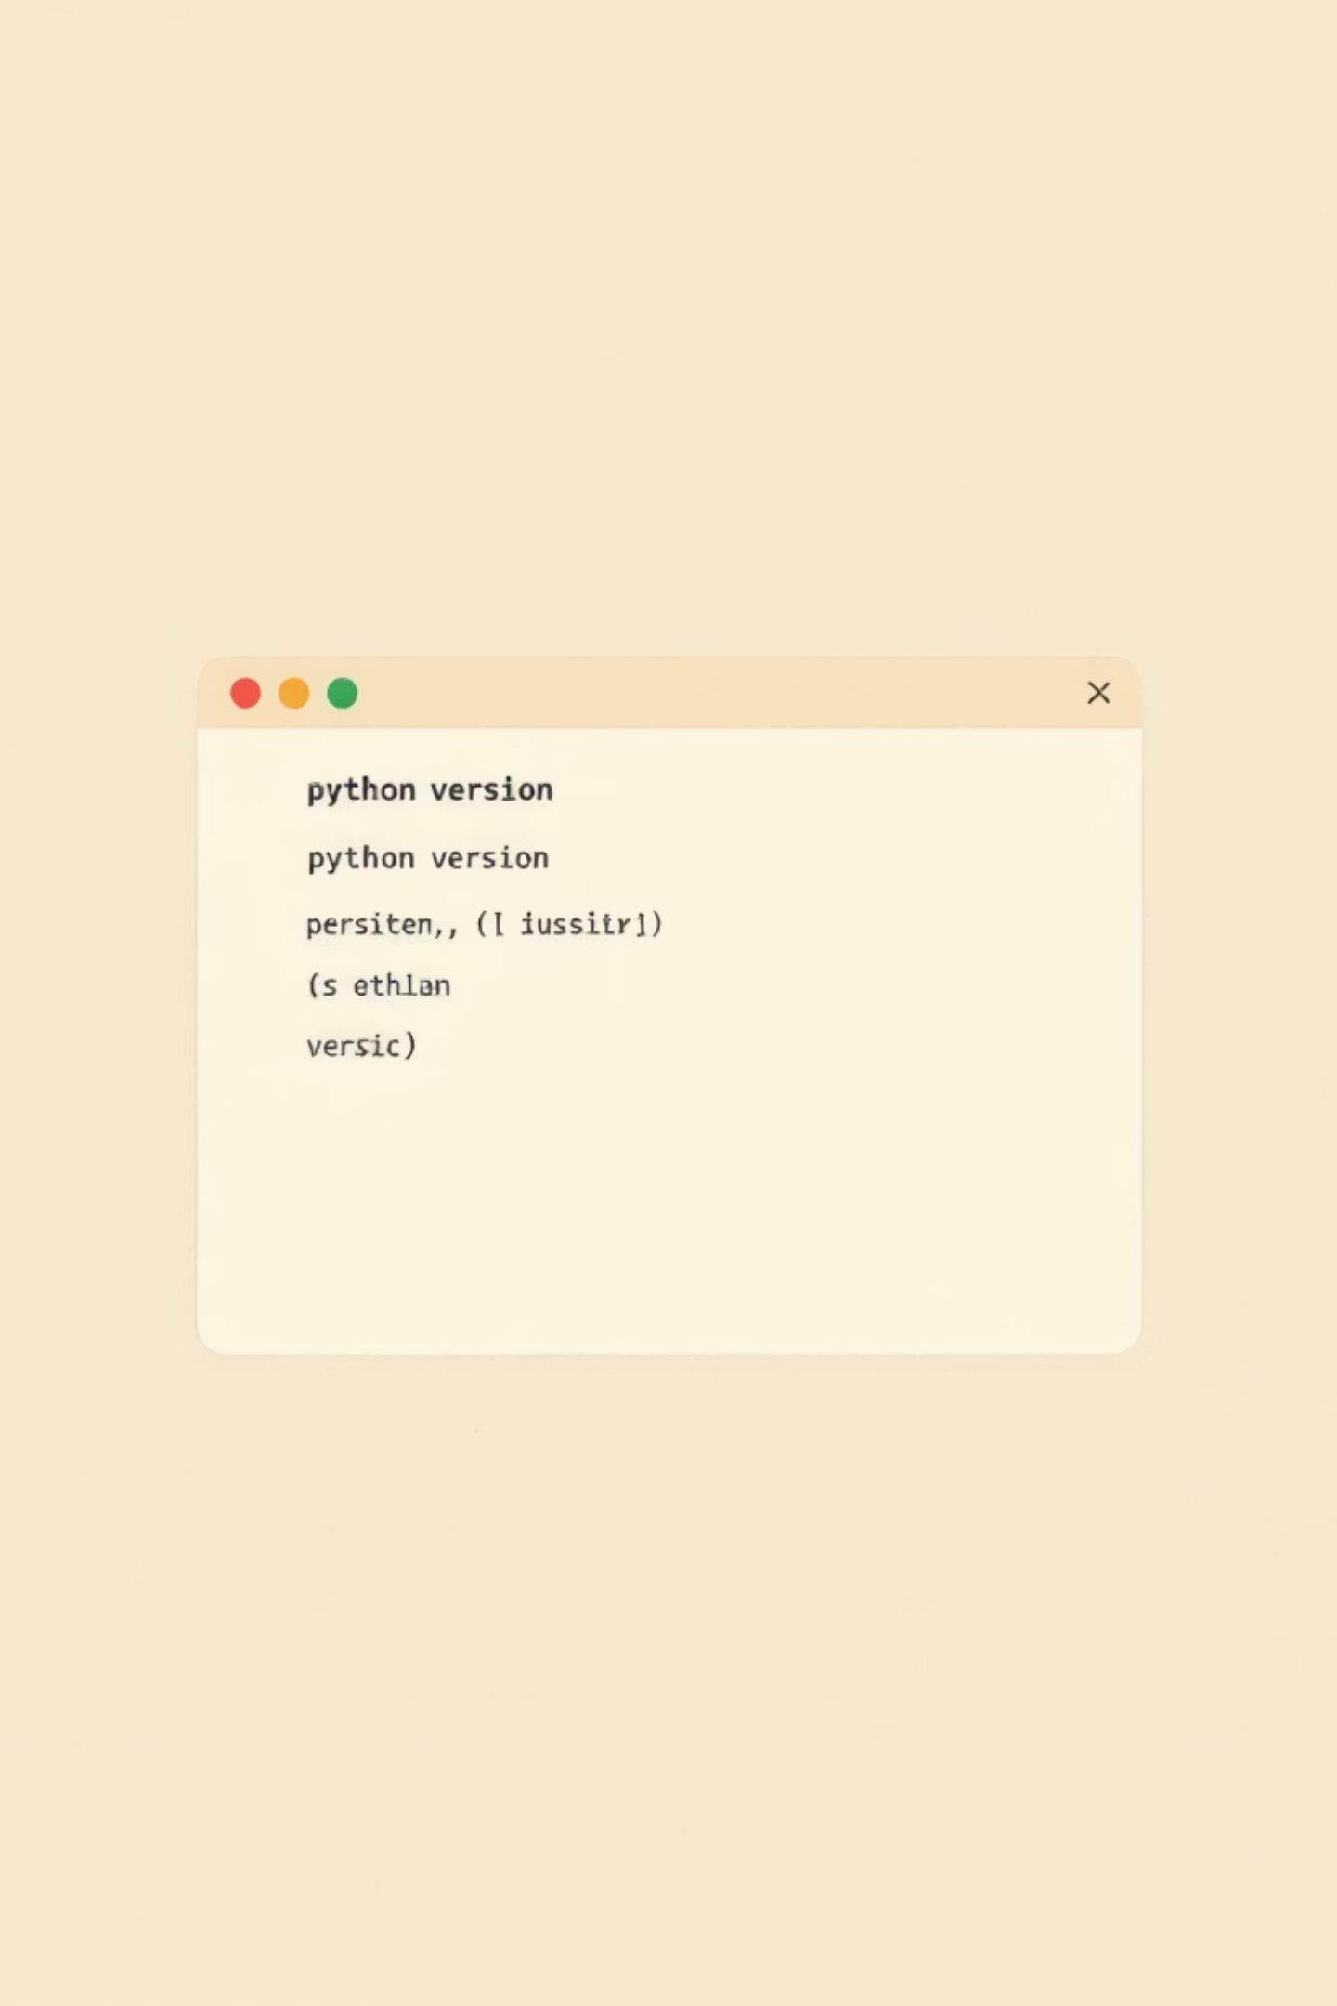



Setting Up Your Python Environment
Install Python
Download and run the installer, ensuring you check "Add Python to PATH" during installation.
Install VS Code
Download Visual Studio Code and add the Python extension for enhanced editing capabilities.
Verify Installation
Open terminal or PowerShell and run python --version to confirm successful setup.
Automated Option: Windows users can leverage Microsoft's WinGet configuration file to install Python and essential tools with a single command, streamlining the entire setup process.

Slide 5
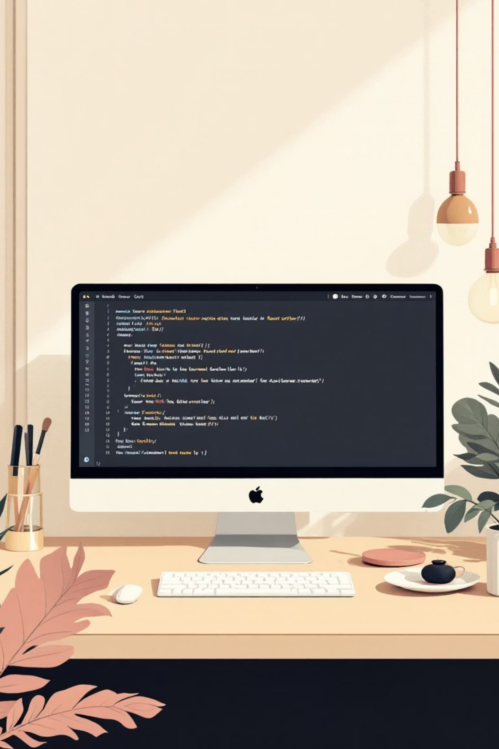
Choosing and Setting Up an IDE
Visual Studio Code (Recommended)
Free, cross-platform editor with rich Python support. Install the Python extension for syntax highlighting, debugging, linting, and intelligent code completion (IntelliSense).
PyCharm
Professional-grade IDE with advanced features. Community edition is free and perfect for dedicated Python development.
Jupyter Notebook
Interactive environment ideal for data science, exploration, and sharing code with visualizations inline.
IDLE
Simple IDE bundled with Python installation. Great for quick scripts and learning the basics without extra setup.

Slide 6
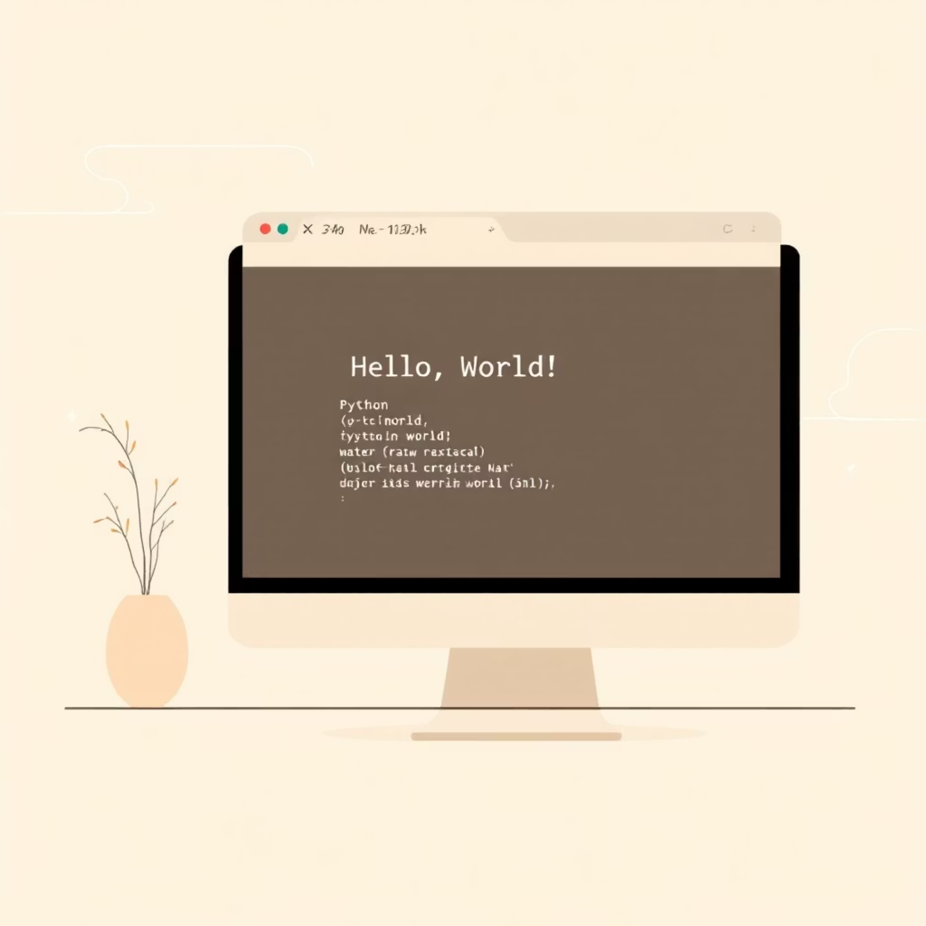
Python Basics: Your First Steps
Welcome to Python Syntax
Python's design philosophy emphasizes code readability with clean, English-like syntax that makes programming accessible to beginners.
Your First Program:
print("Hello, World!")
This single line displays text output to the console—simple yet powerful!
Indentation Matters
Python uses whitespace (spaces or tabs) to define code blocks. No curly braces needed—clean and readable by design.

Slide 7
Understanding Python Data Types
Python provides several built-in data types that form the foundation of all programs. Mastering these core types is essential for effective programming.
Integers (int)
Floats (float)
Strings (str)
Booleans (bool)
Whole numbers without decimals, positive or negative. Examples: 5, -3, 1000
Numbers with decimal points for precision. Examples: 3.14, -0.001, 2.0
Text data enclosed in quotes, single or double. Examples: "Python", 'Hello!'
Logical values representing truth. Only two values: True or False

Slide 8
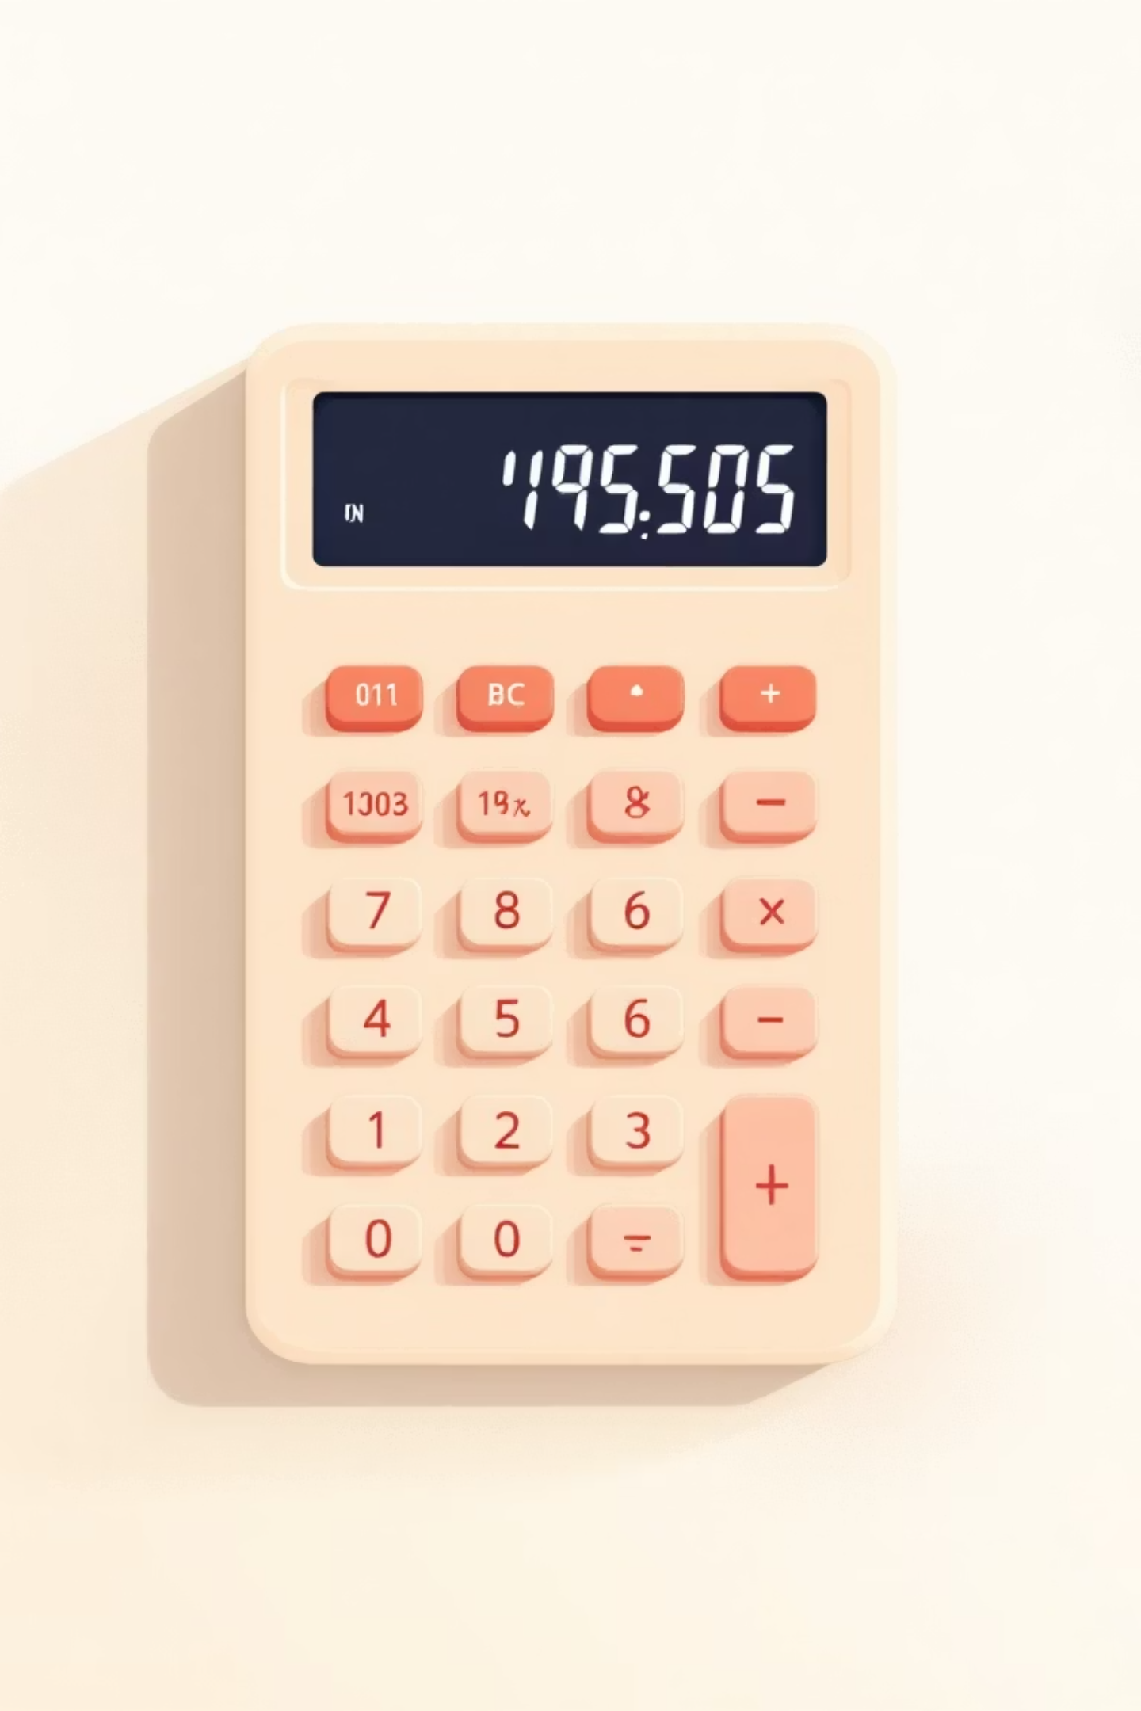
Working with Integers and Floats
Integers: The Counting Numbers
Floats: Decimal Precision
Essential for measurements, scientific calculations, and any math requiring decimal accuracy.
Perfect for discrete values like counting items, indexing lists, or loop iterations.
x = 10
count = 42
index = -1
y = 3.5
pi = 3.14159
temperature = -0.5
Python handles arbitrarily large integers without overflow—no limits on size!
Python manages floating-point precision automatically, though rounding may occur in extreme cases.

Slide 9
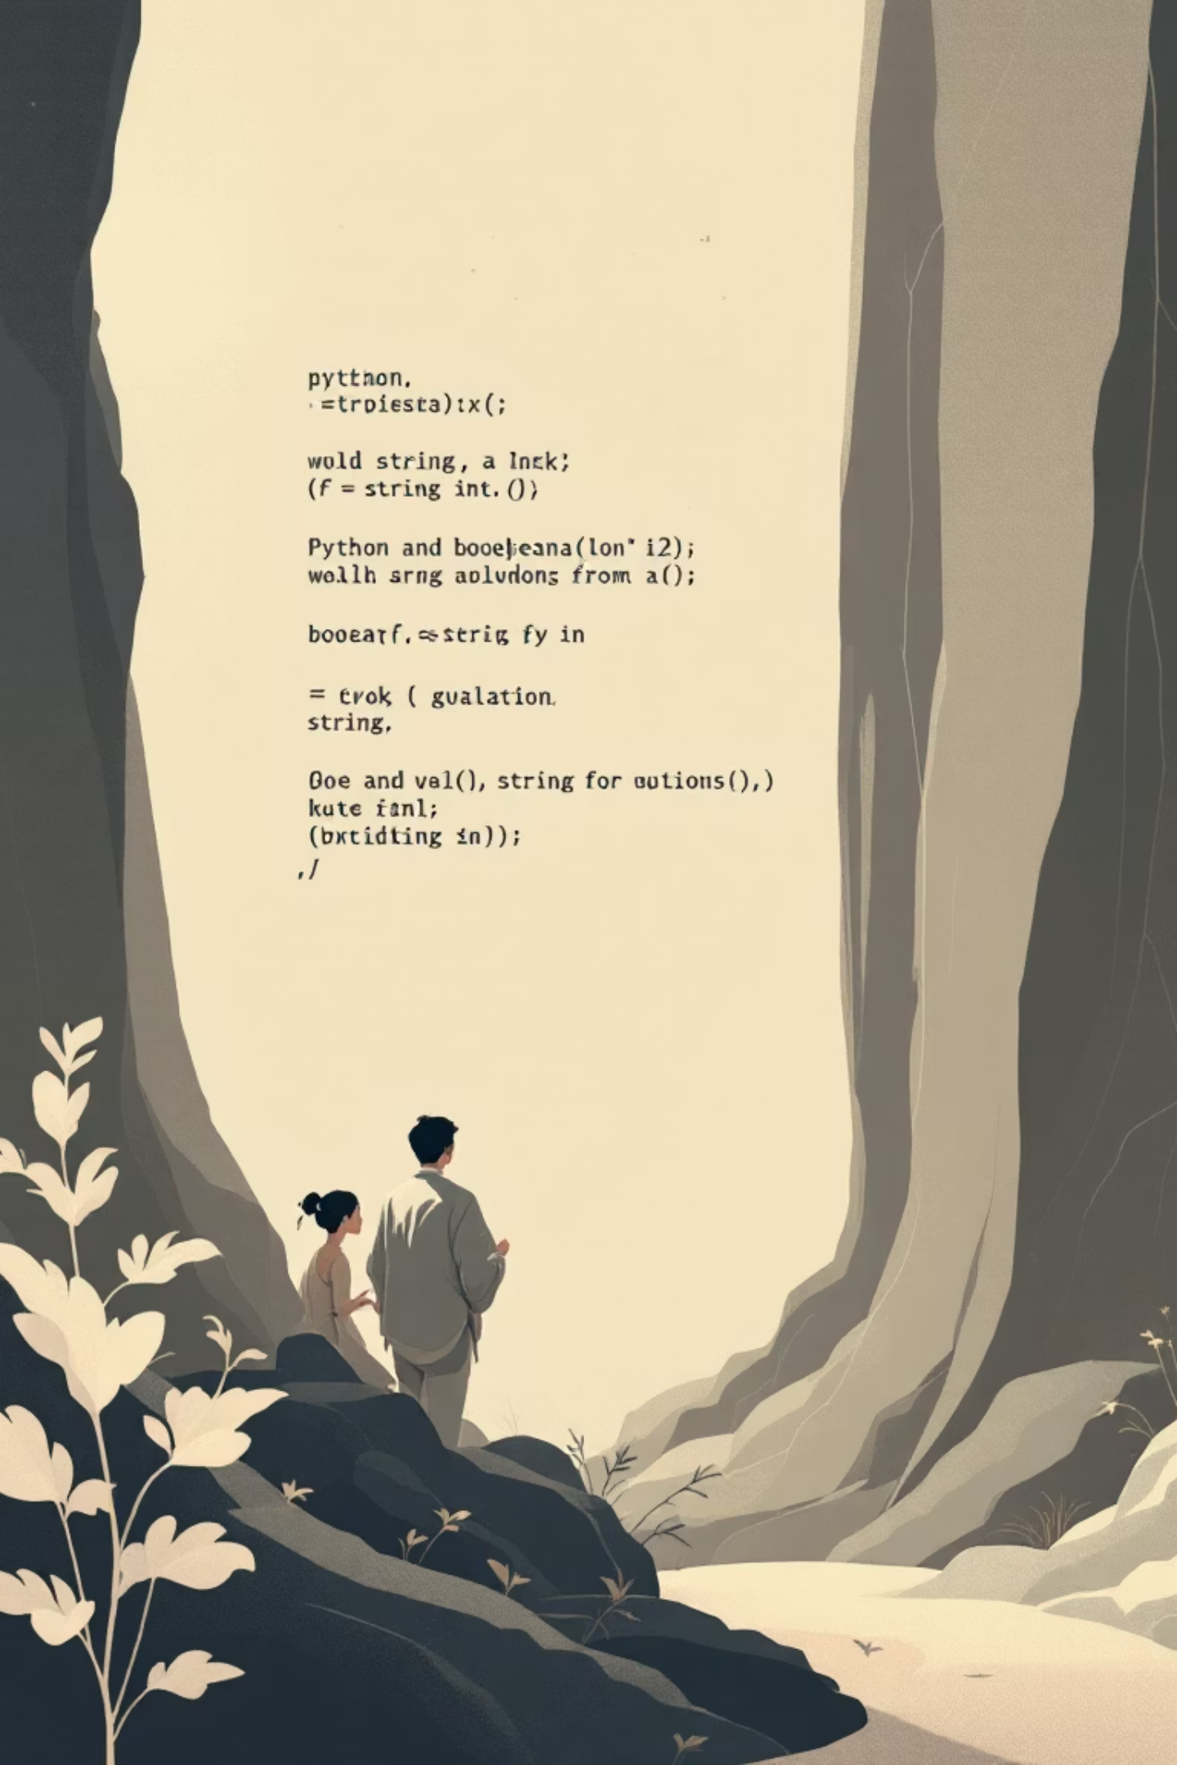
Strings and Booleans Explained
Strings: Text Manipulation
Sequences of characters supporting powerful operations:
Concatenation: "Hello" + " World" → "Hello World"
Slicing: "Python"[0:3] → "Pyt"
Methods: "text".upper() → "TEXT"
Booleans: Logic & Control
Result from comparisons and logical operations:
Comparison: 5 > 3 → True
Logical AND: True and False → False
Logical OR: True or False → True

Slide 10

Type Conversion in Python
Converting between data types is essential for handling user input, processing data, and preventing errors. Python provides built-in functions for seamless type conversion.
int()
str()
Convert to integer
Convert to string
int("123") → 123
int(3.9) → 3
str(123) → "123"
str(3.14) → "3.14"
1
2
3
4
float()
bool()
Convert to float
Convert to boolean
float("3.14") → 3.14
float(5) → 5.0
bool(1) → True
bool(0) → False
Watch Out: Invalid conversions raise errors. For example, int("hello") fails because "hello" isn't a valid number. Always validate data before converting!

